Slide 1


Slide 2

FREE JAVA PROJECT BATCH

Slide 3

What Is This Workshop All About?
STUDENTS LOVE OUR INITIATIVE AND IT’S RATING IS 4.8 STAR. THIS IS OUR HIGHEST RATED BATCH
6
WE HAVE DONE 6 PROJECTS TILL NOW IN THIS BATCH AND THIS IS OUR SEVENTH PROJECT
5
MORE THAN 5000 JAVA DEVLOPERS HAVE DONE THEIR FIIRST PROJECT WITH US
MAINLY AIMED TOWARDS IMPROVING PRACTICAL SKILLS OF OUR STUDENTS
4
3
STARTED IN JULY 2017
2
AN SCA INITIATIVE
1

Slide 4
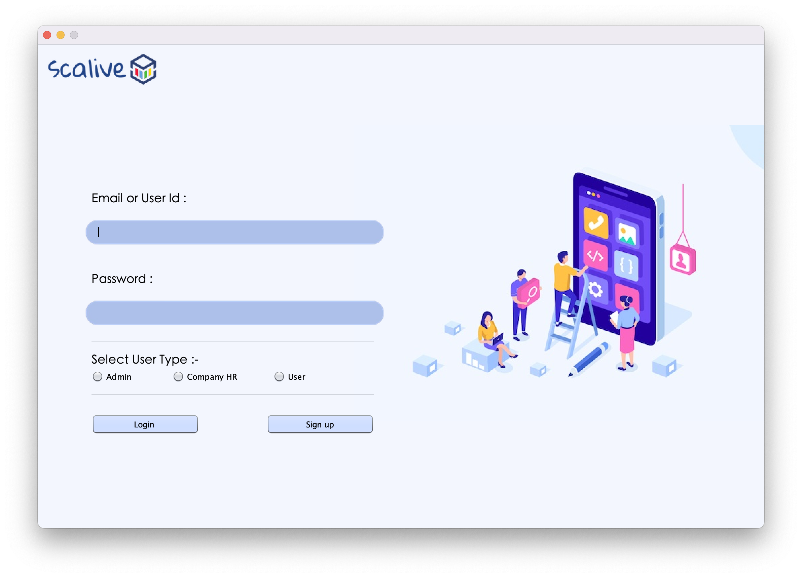
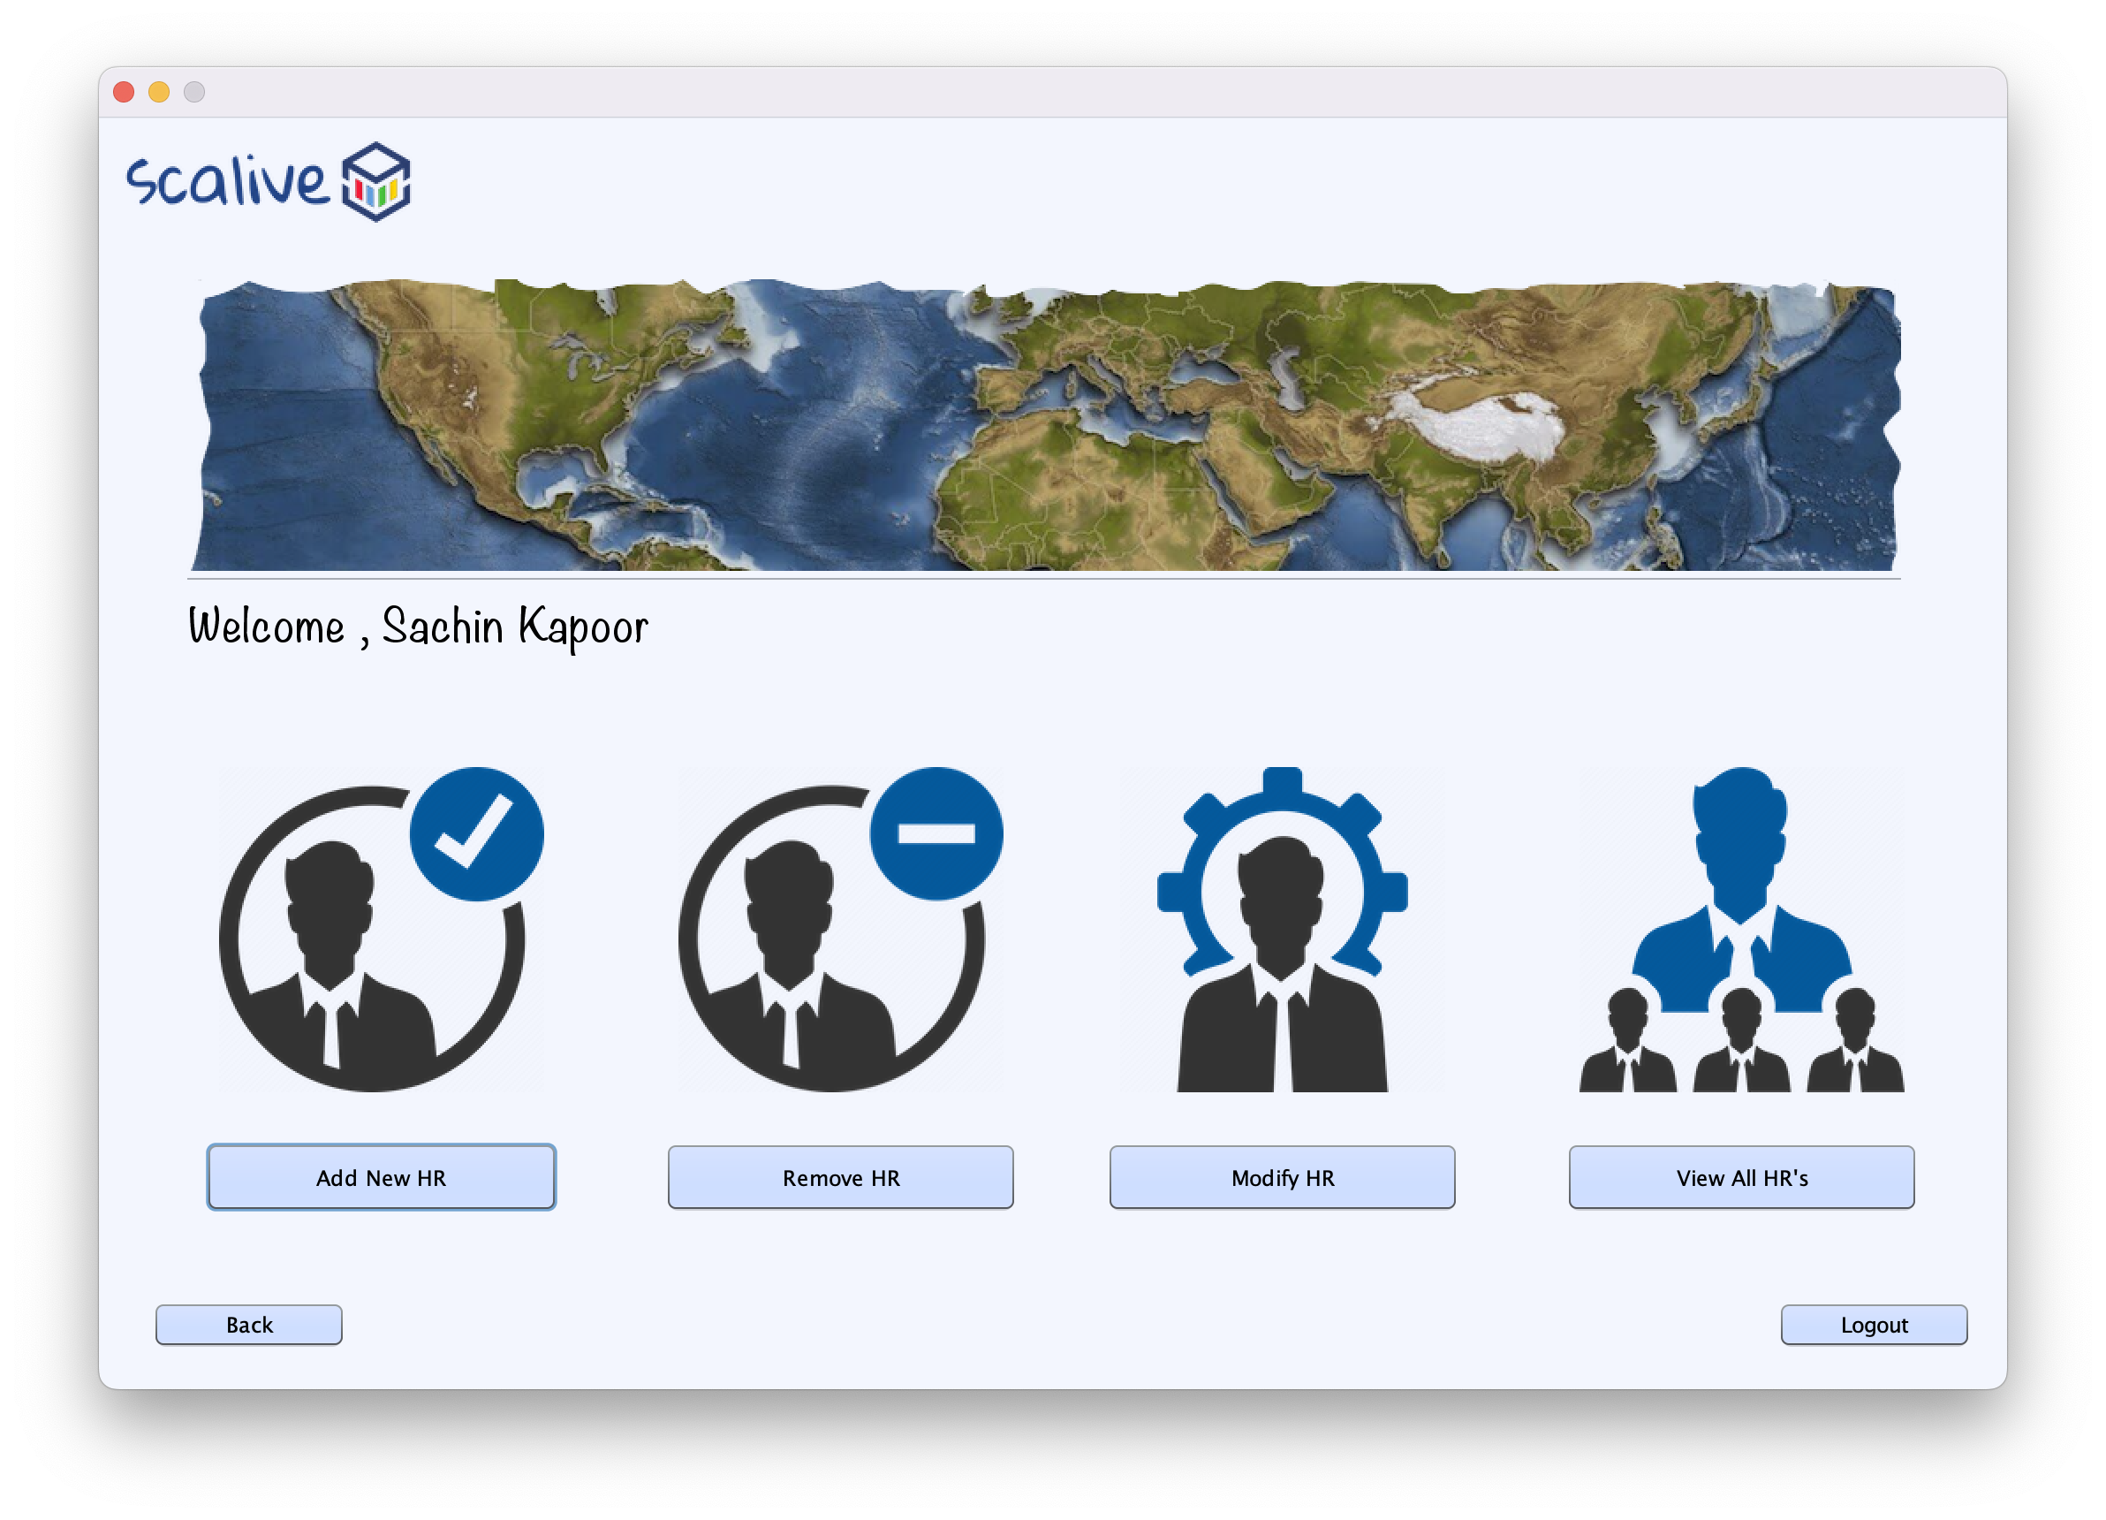
Our Projects !!!
6
Training & Placement Application

Slide 5
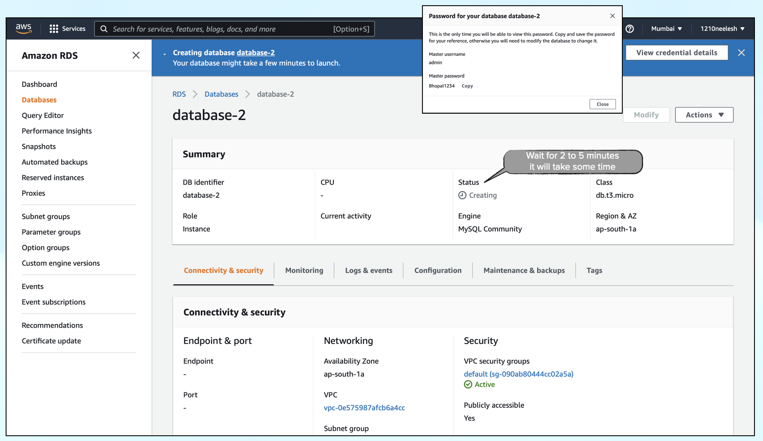
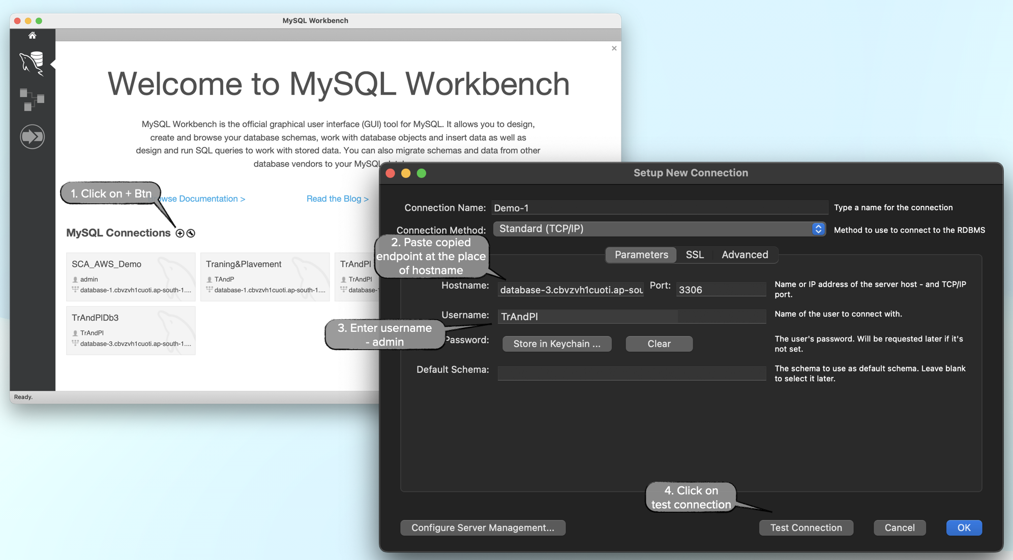
Our Projects !!!
AWS RDS Implementation in Training & Placement App
Training & Placement Application

Slide 6
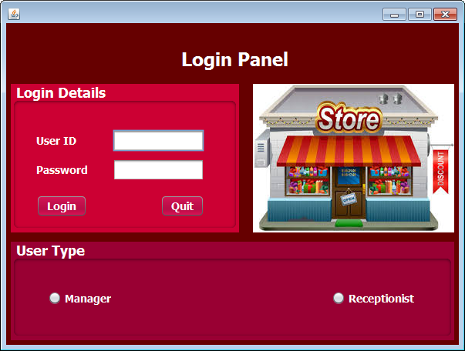


Our Projects !!!
Stock Management System
5

Slide 7
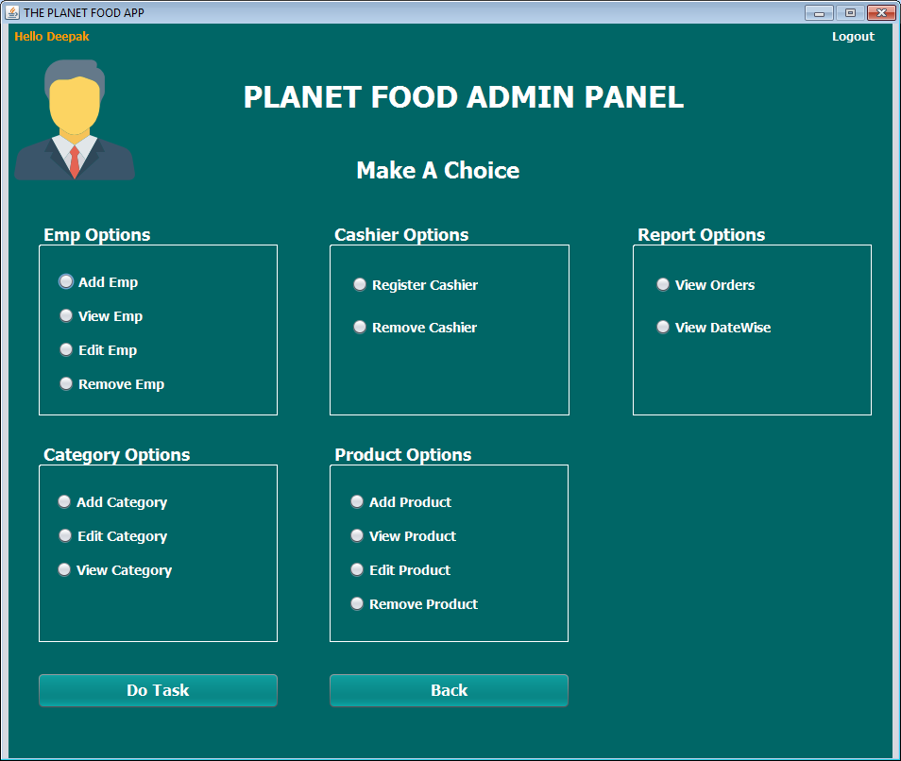
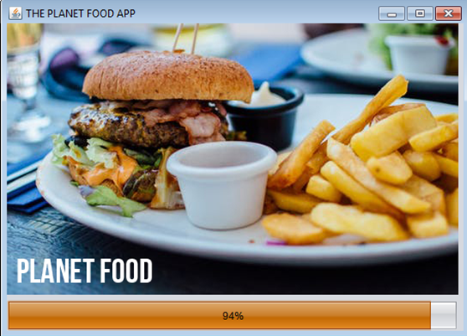
Our Projects !!!
Planet Food App
4

Slide 8
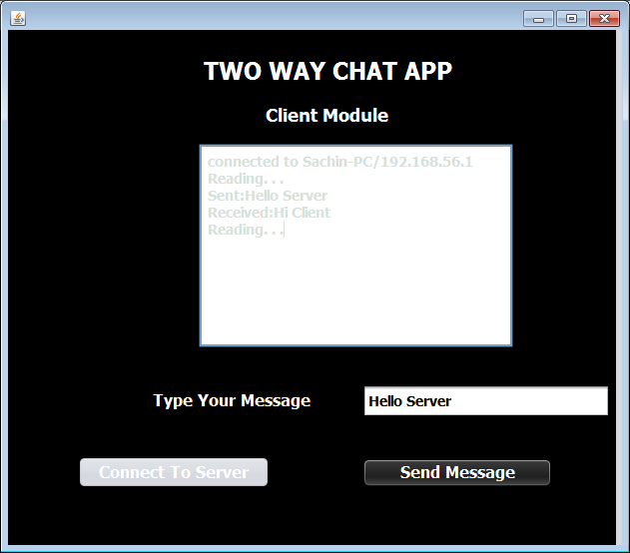
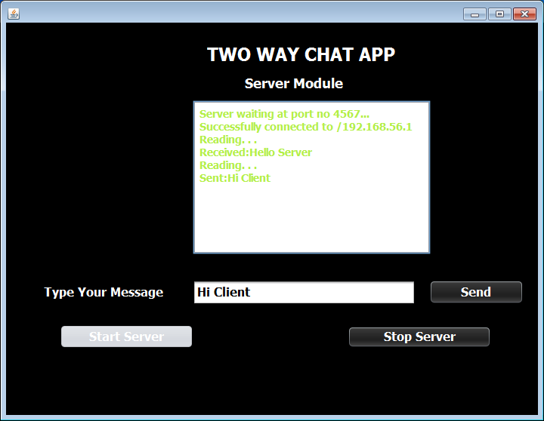
Our Projects !!!
Chatting App
3

Slide 9
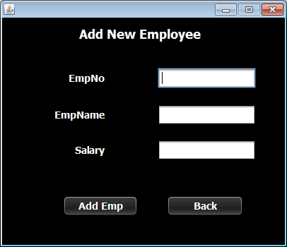
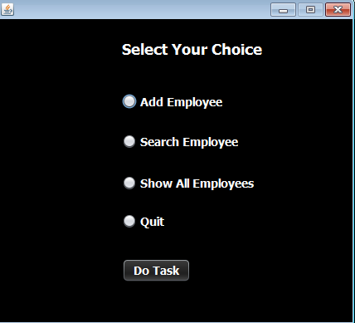
Our Projects !!!
Employee Management System
2

Slide 10
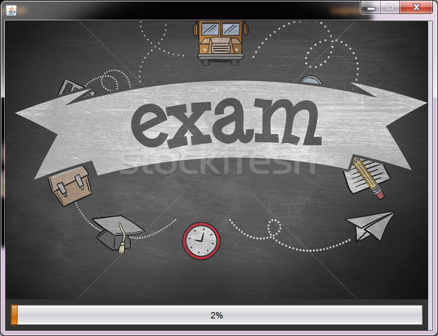
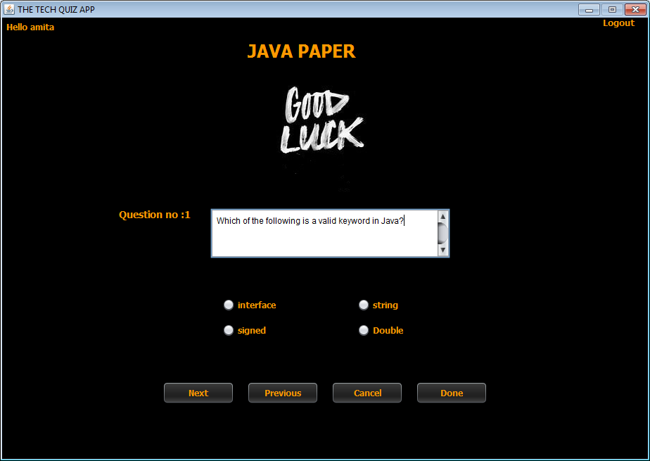
Our Projects !!!
Tech Quiz App
1

Slide 11

Key Highlights
DEVELOP A PROJECT
LEARN INDUSTRY
STANDARD
ON THE SPOT PRACTICALS
ASSIGNMENTS
CERTIFICATE

Slide 12
Pre Requisites
Basic Java Concepts –
Encapsulation
Inheritance
Polymorphism
Interfaces
Exception Handling
Exception Handling Basics
Checked And Unchecked Exception
Collections
Array List
HashSet
Hash Map

Slide 13


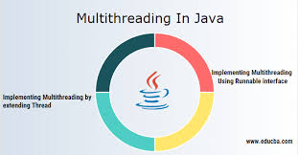

What We Will Learn ?
03
API Integration,
OTP Verification,
Password Encryption
01
GUI Programing
02
04
Multithreading
JDBC

Slide 14
Required Software
1
JDK 8
2
Netbeans 8.2
3
Oracle 10g/11g

Slide 15
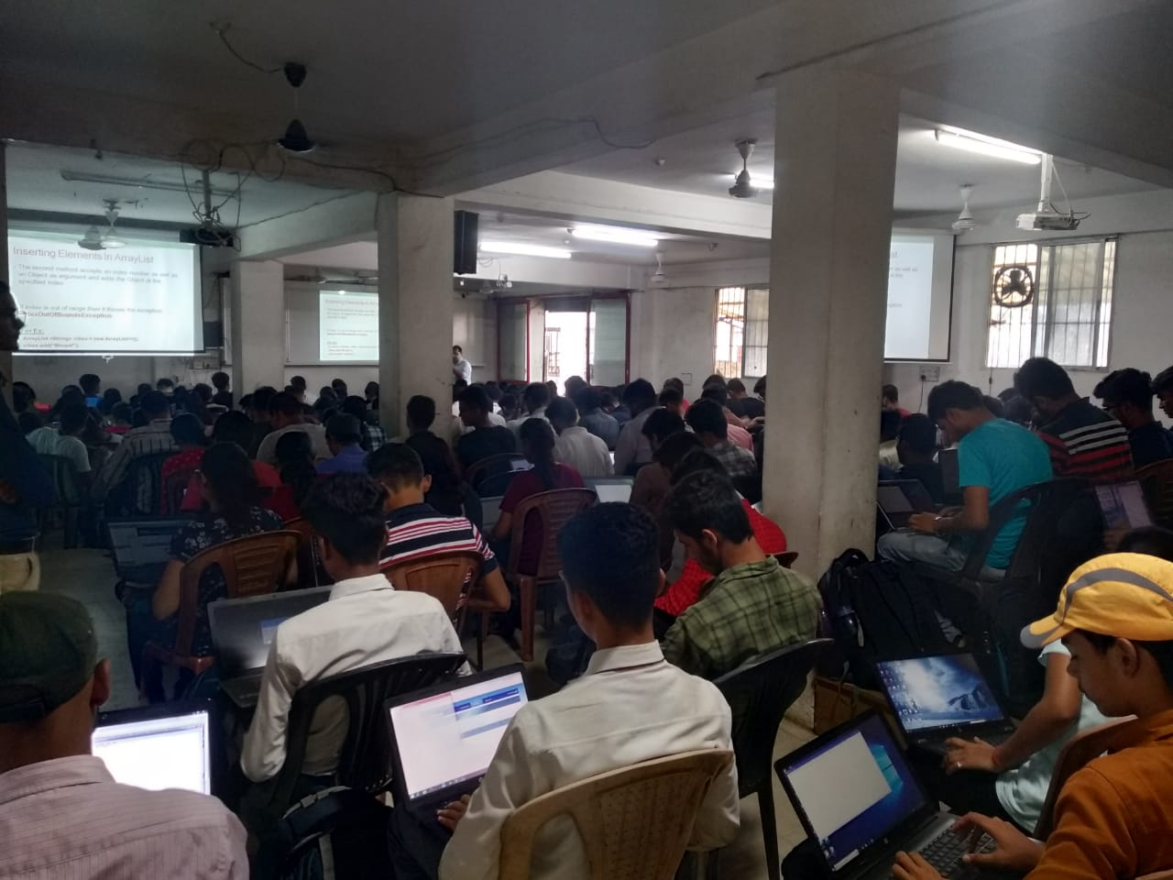
Ready For Project
START

Slide 16
Introduction To The Project
In India many e-hospital systems are available like SIMPLEX HIMES, SEHAT,Practo etc .
All of them include some common features like Reduced Paperwork, simple access to records, no record duplications, improve cost control etc for managing their activities

Slide 17
Introduction To The Project
Our application is called Sanjeevani App.
Sanjeevani App is a complete solution that can be deployed and customized for any hospital management system.
It is based upon SMS API Feature which will produce Custom OTP for mobile number verification and SMS for appointment confirmation

Slide 18
Motivation For The Project
We will be developing this software because of the following reasons:
Reduction in manual efforts
Simple access to reference records.
Zero paper work

Slide 19
Key Features Of Our Project
OTP CONFIRMATION
01
SMS API
02
MANAGE EMPLOYEES, RECEPTIONISTS & DOCTOR
03
MANAGE PATIENTS
04

Slide 20

Modules In The Project
Admin
Receptionist
Doctor

Slide 21
Admin Module
Manage Doctors
View All Patients
Manage Receptionists
Manage Employees

Slide 22
Receptionist Module
Add Patient
The Receptionist can manage the patient by adding, updating, deleting and viewing the details of the patient.
Verify Number
The Receptionist can verify the mobile number of the patient by sending him an OTP.

Slide 23
Doctor Module
Appointment Request
The Doctor can view the patient’s appointment request to him.
Confirm Appointment
The Doctor can confirm the appointment and appointment details will be send to the patient’s mobile number.

Slide 24
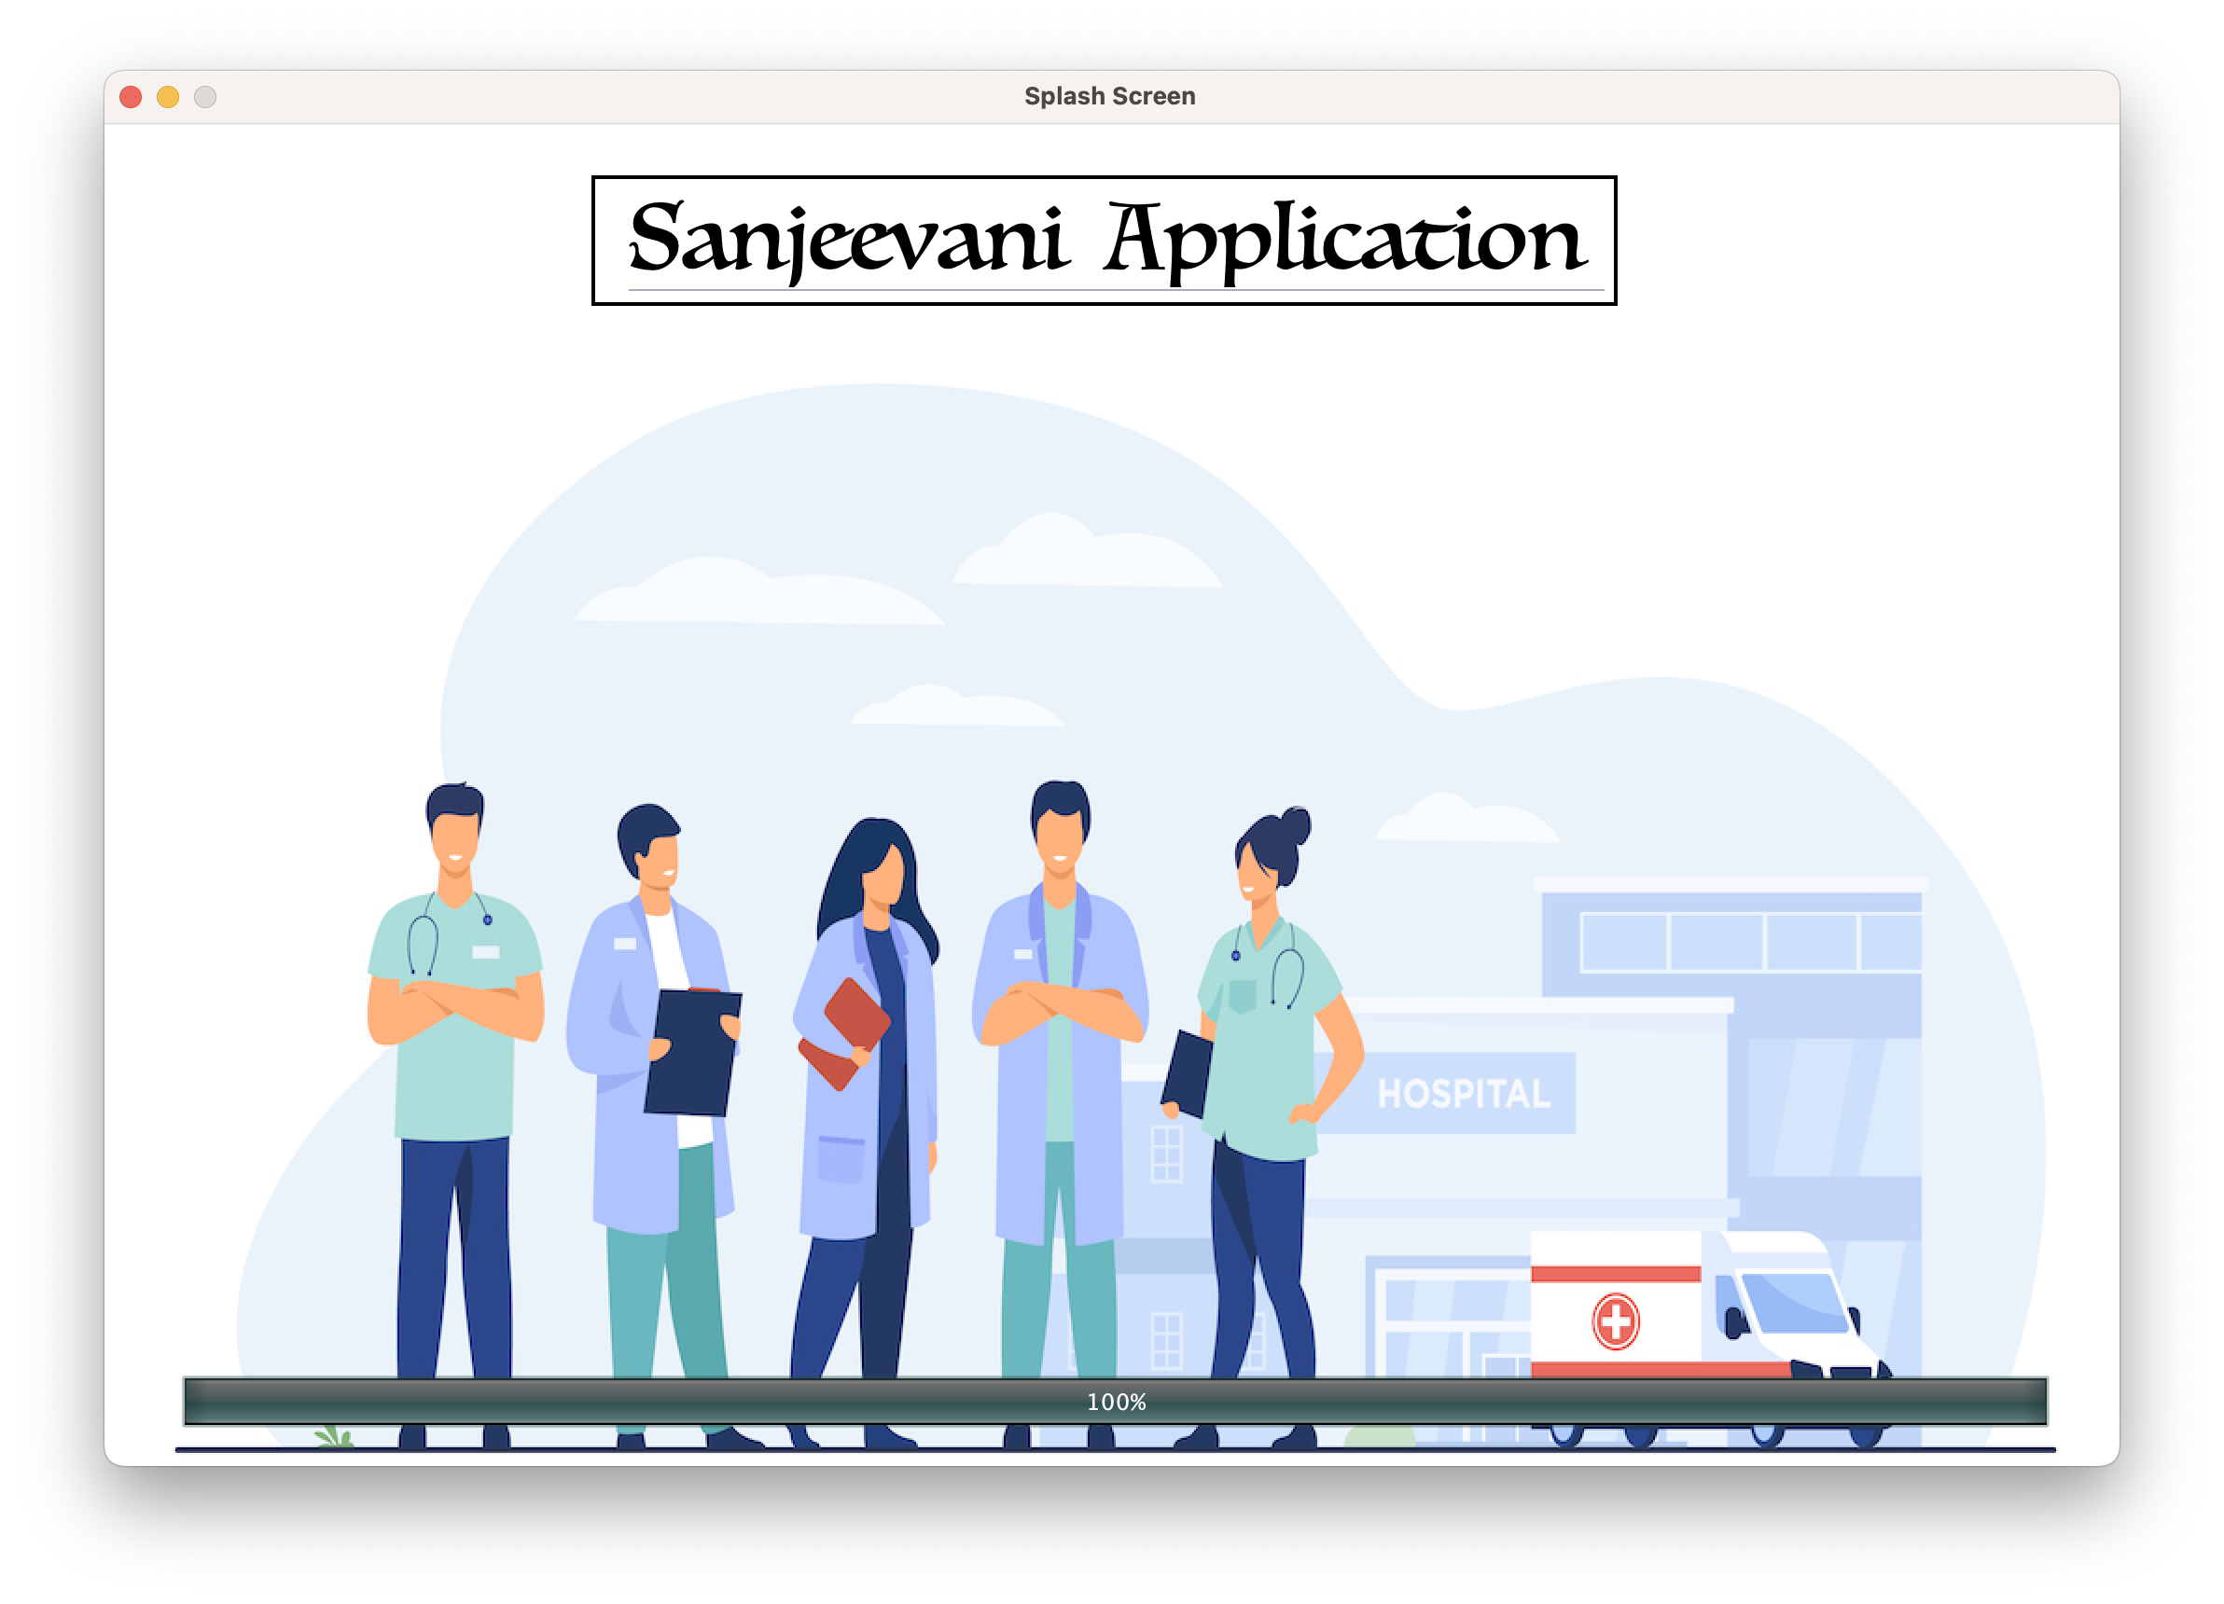
Screen Shots

Slide 25
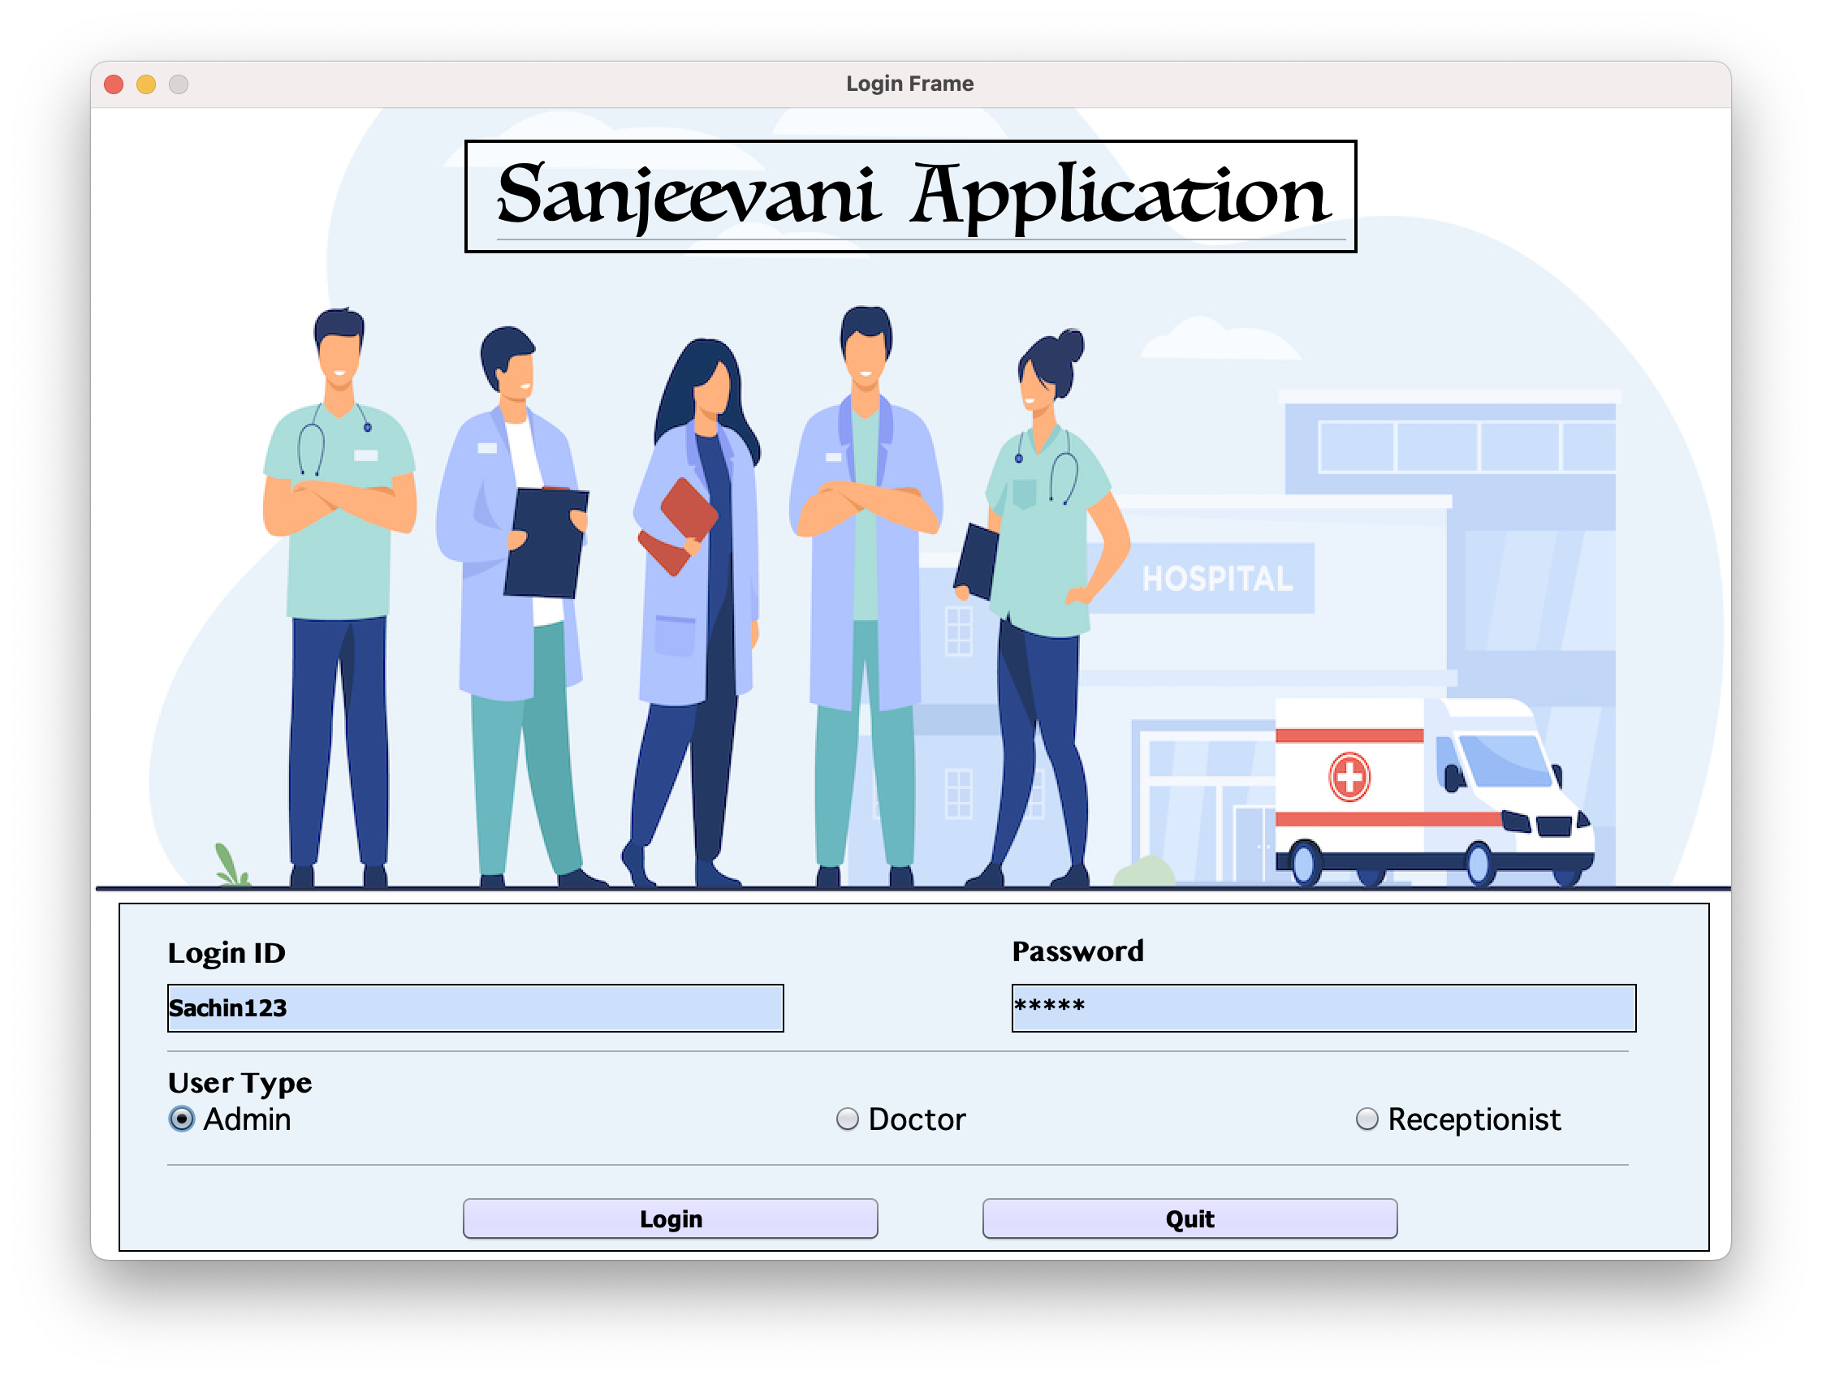
Screen Shots

Slide 26
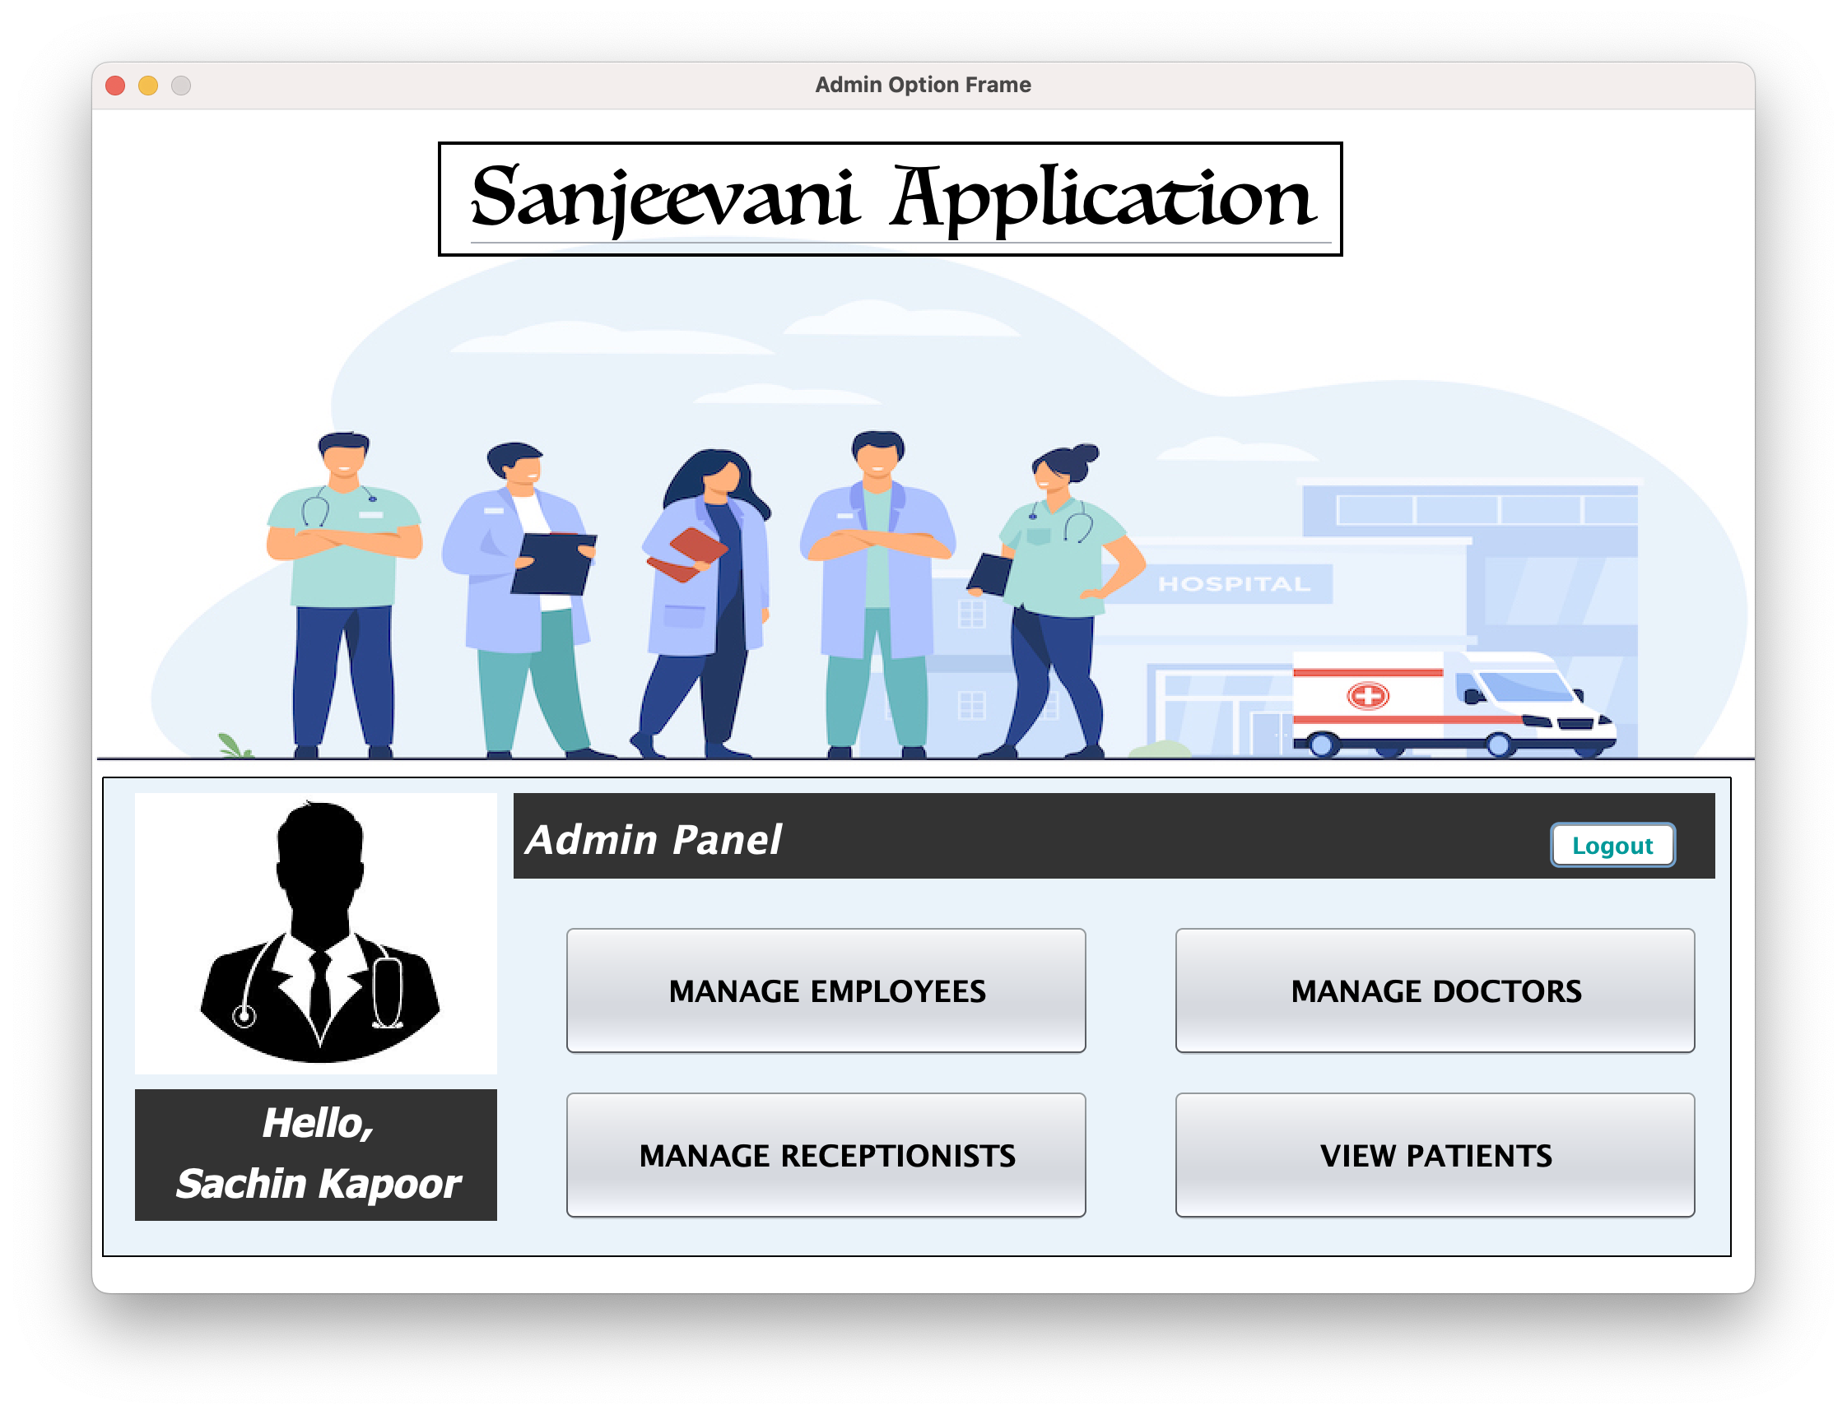
Screen Shots

Slide 27
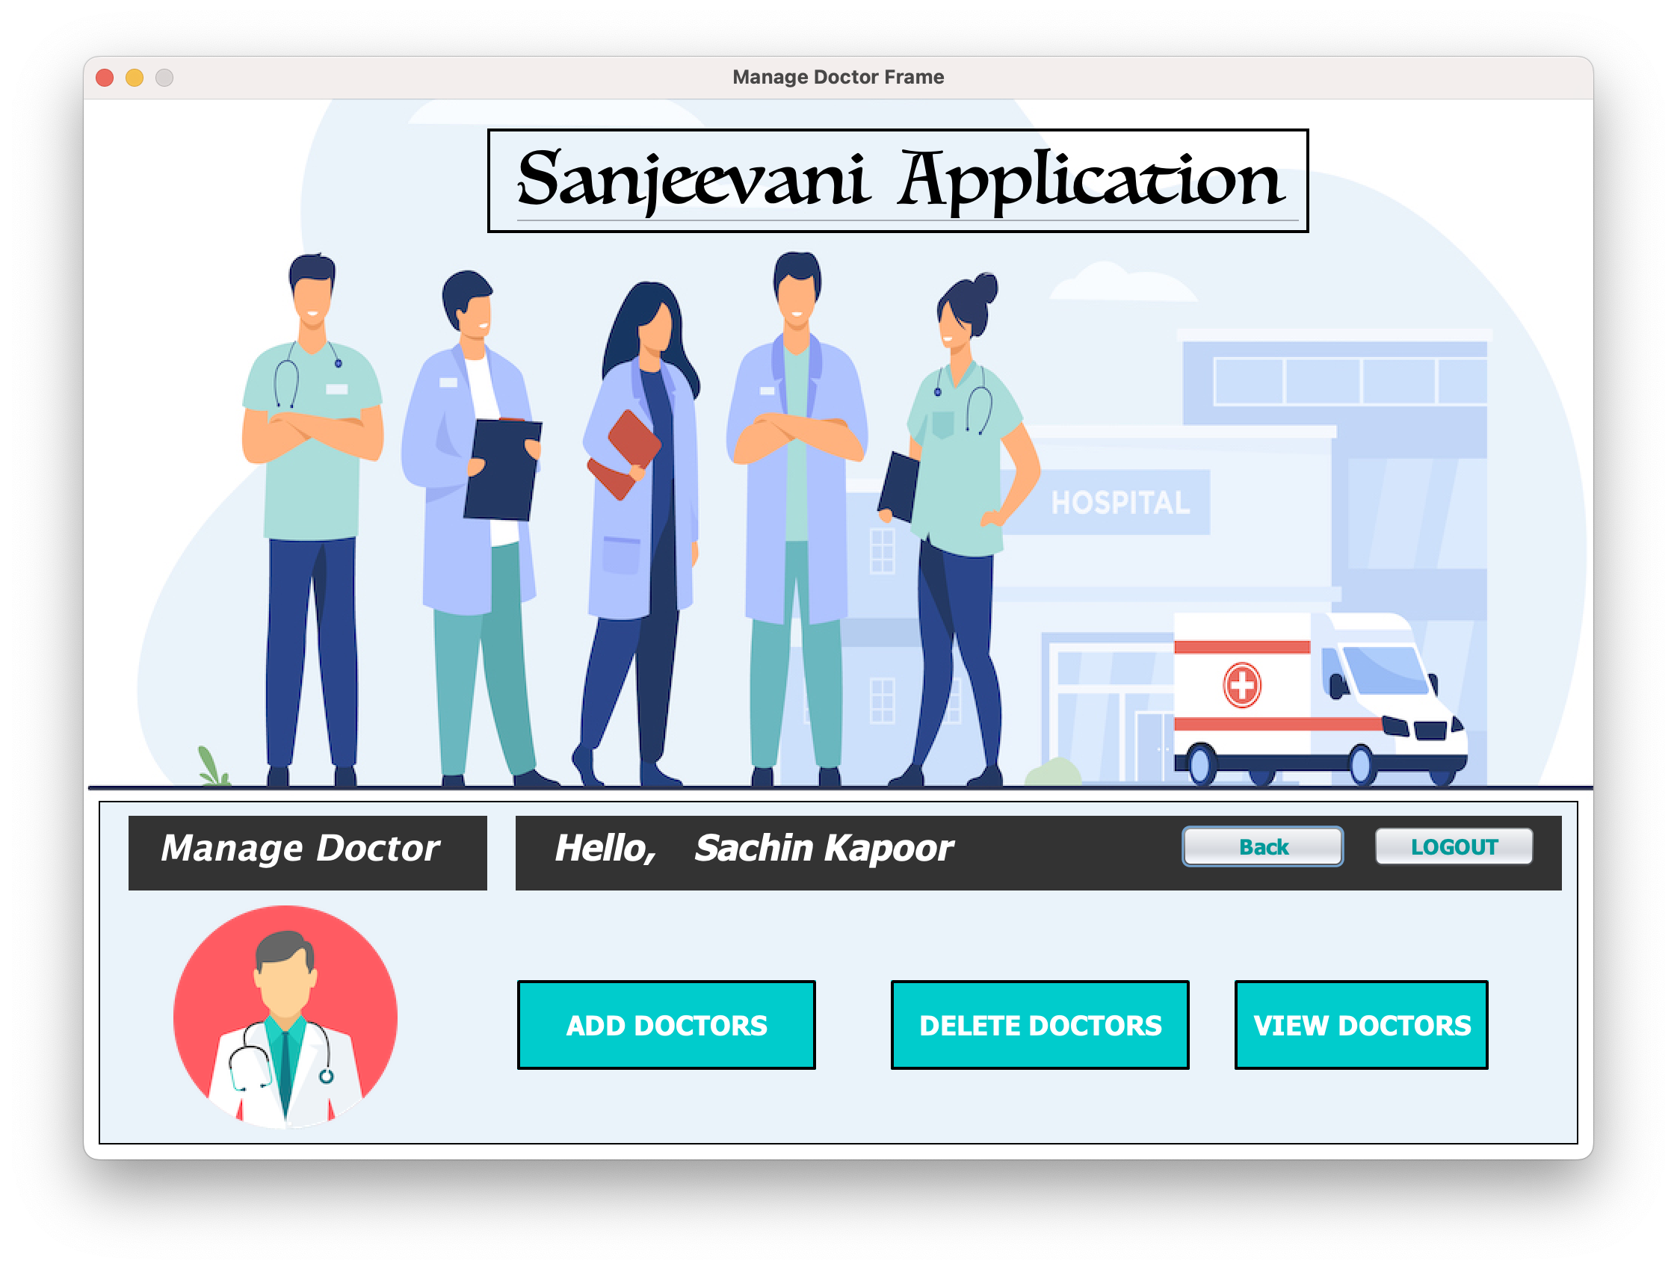
Screen Shots

Slide 28
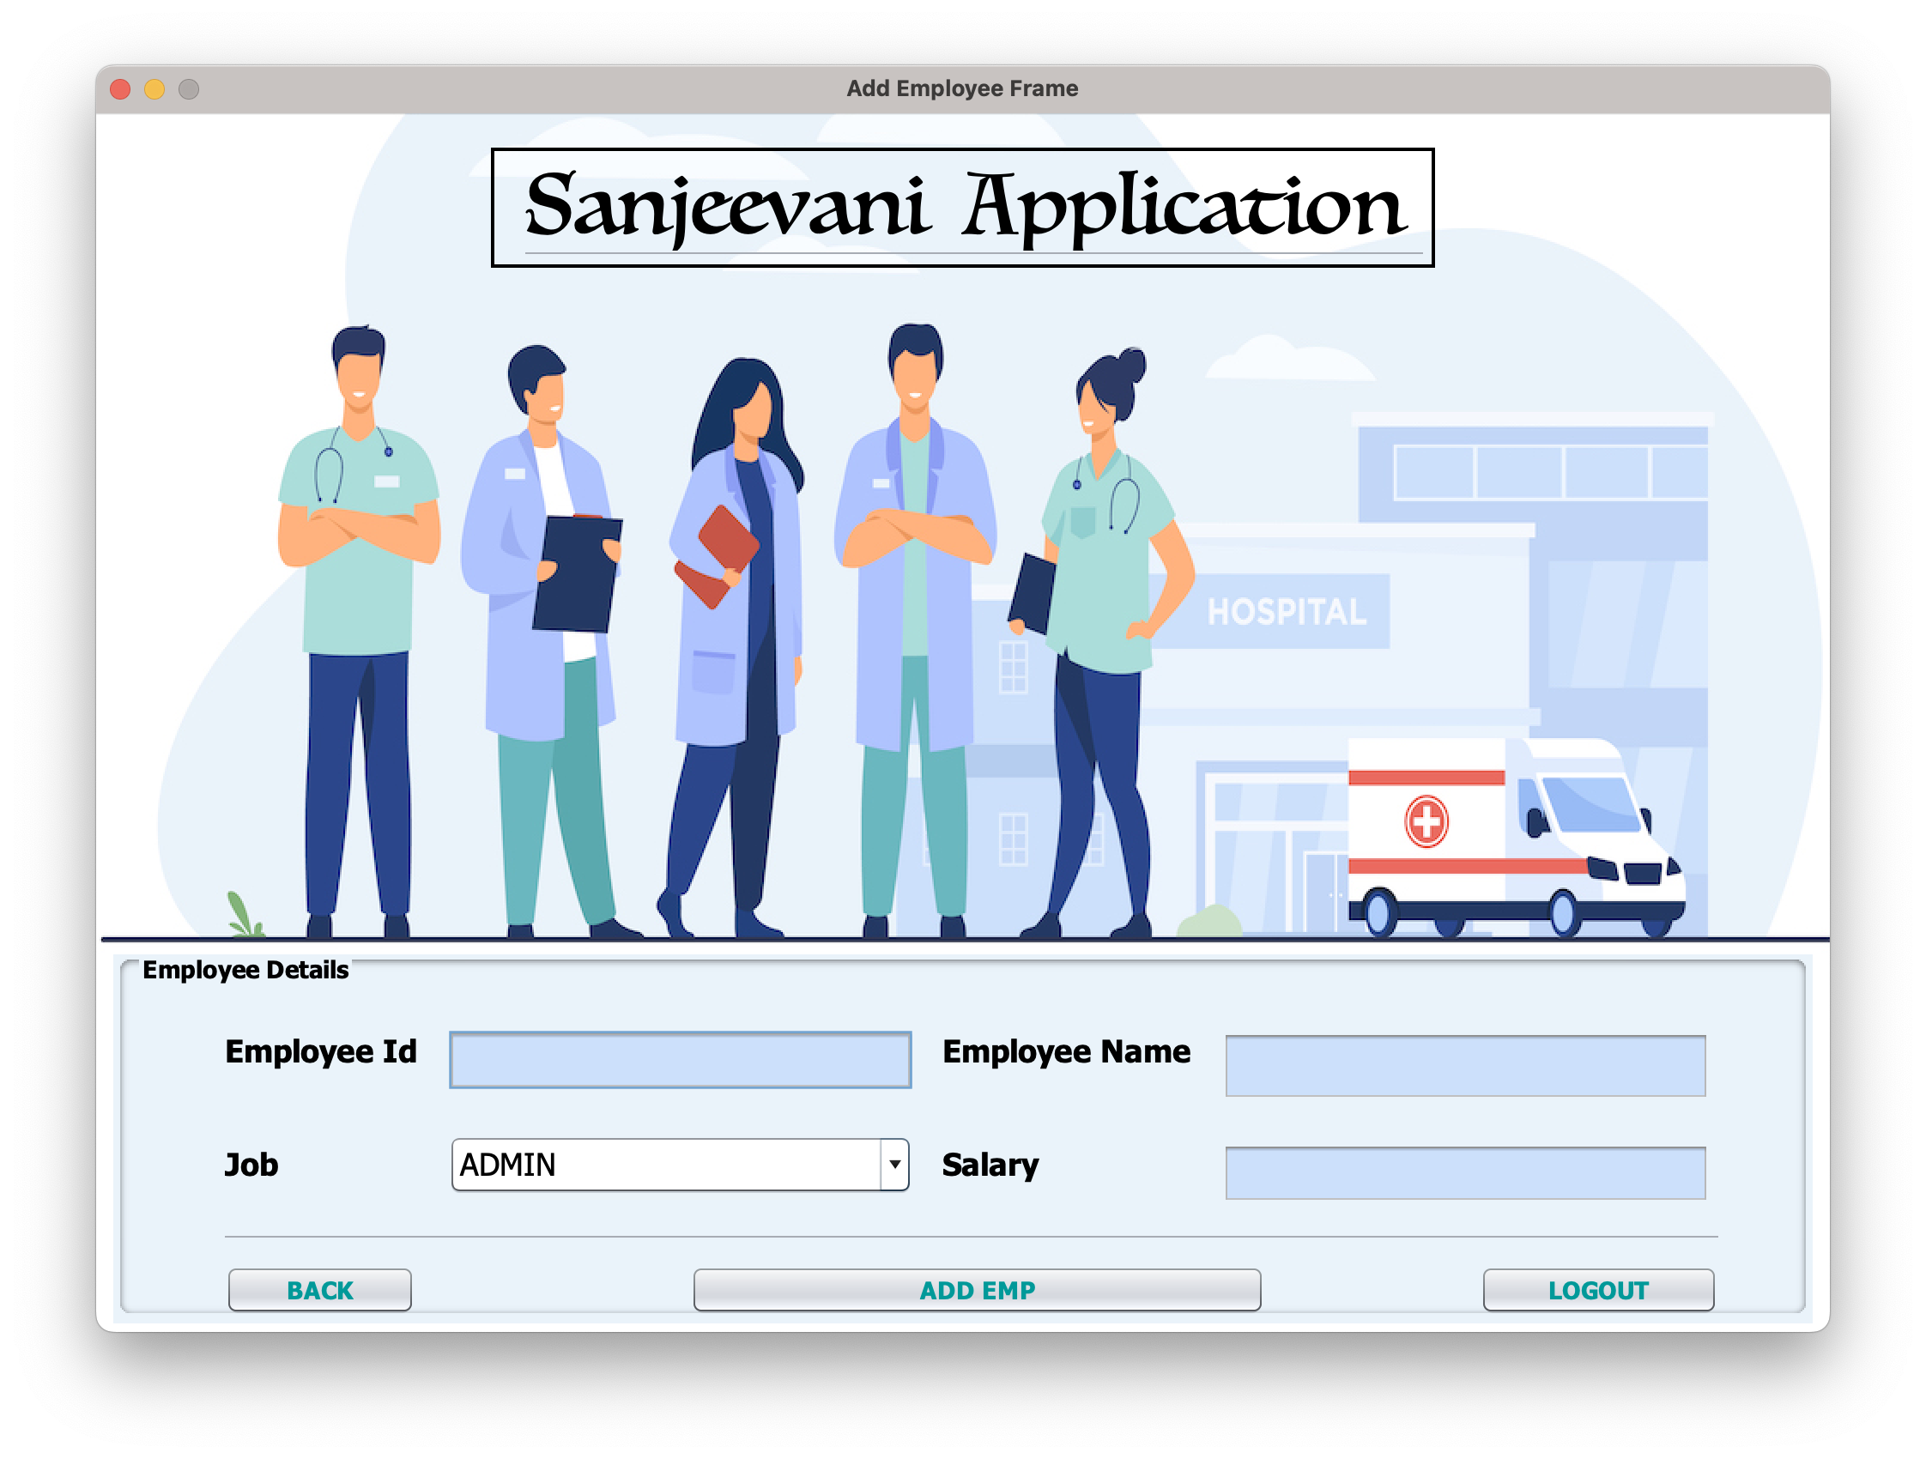
Screen Shots

Slide 29
Project Enrollment Process -
Appears in Project Entrance Test on ( 31/12/2022 )
Topics -
Java Basics
OOPs Concept
Collections
On the basis of Cutoff Student will get project batch allotment

Slide 30
Project Completion & Internship Certificates Conditions
100% Attendance
Satisfactory project performance
Timely completion of Assignments
Timely completion of project with source code and video of the project

Slide 31

Batch Schedule
Tuesday, Thursday ,Saturday and Sunday(on requirement)
( Sometimes off depending on progress)
Timing: 8:00 PM
Topics: GUI & SQL
Test Date: Saturday, 31st Dec, 12:00 PM to 7:00 PM
First Class: Tuesday , 3rd Jan , 8:00 PM

Slide 32


Useful Links
Telegram Link: t.me/scajpb3
Entrance Test Schedule Link:
bit.ly/scaete
Official Telegram Channel:
t.me/scaofficialchannel

Slide 33

For more information call us: +919826686245, +917870554215
Between 1pm to 5pm

